Slide 1
KICK-OFF CONFERENCE: Integrity and ethics in the work of local governments The Norwegian Experience Lise Spikkeland, KS 16. september 2021
Notes:
My background:
Responsibilities in KS Local democracy, Councillors training, ethics and anti corruption
What is corruption? Our approach: it has a much wider perspective than someone paying for or having an advantage in political decisions
It threatens
basic democratic values
The principle citizens are treated equal and according to the law
To fight corruption is a fight for democracy
The rule of law
the municipality’s use of resources
he municipality’s reputation
Financial loss
A strain on the working environment
Important to have in mind when

Slide 2
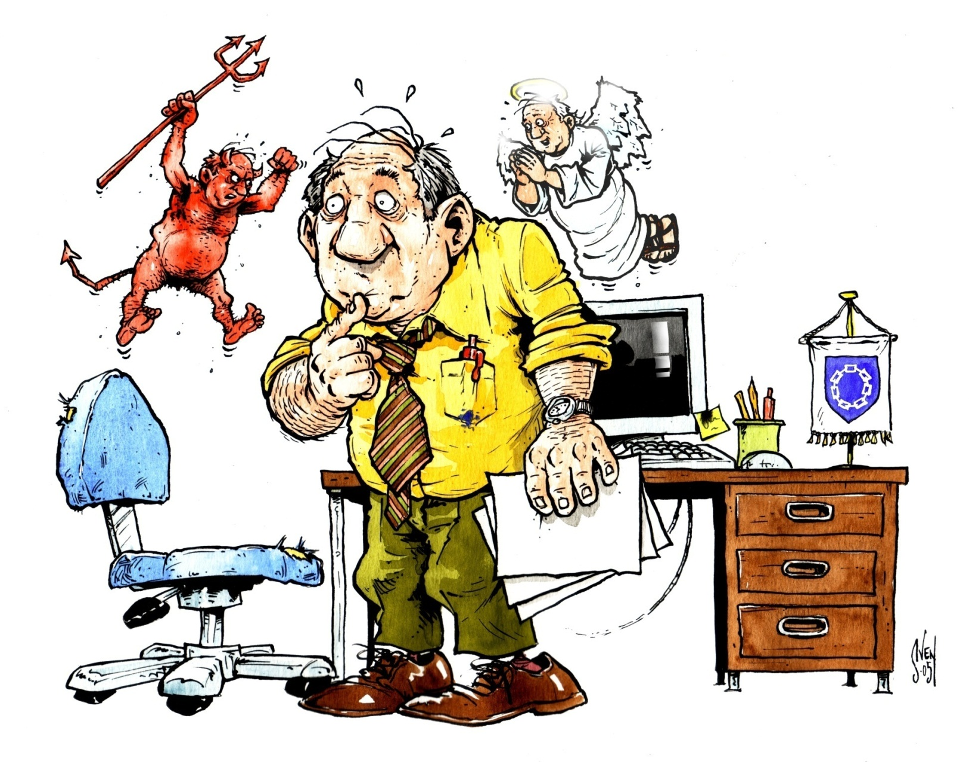
Why is it important
Democracy and trust
Corruption is illegal
Grey zones
Wrongdoing from the inside
Great pressure from the outside
Need help to clarify?

Slide 3
How
Structure
Culture
Ethical guidelines
Risk analysis
Continous at the agenda
Anti-corruption program

Slide 4
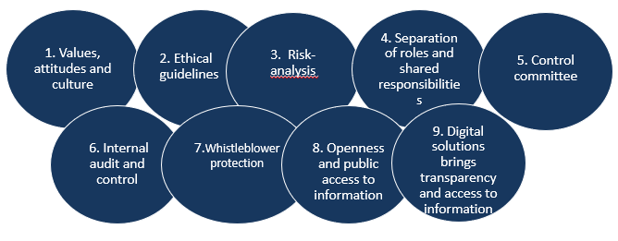
KS role and support
Know how, tools and measures:
Surveys
Committee on ethics
Registers
Networks
Guides on whistleblowing
Guide om ethics
Collection with dilemmas
Councillor training program
Collaboration with Transparency International

